Slide 1
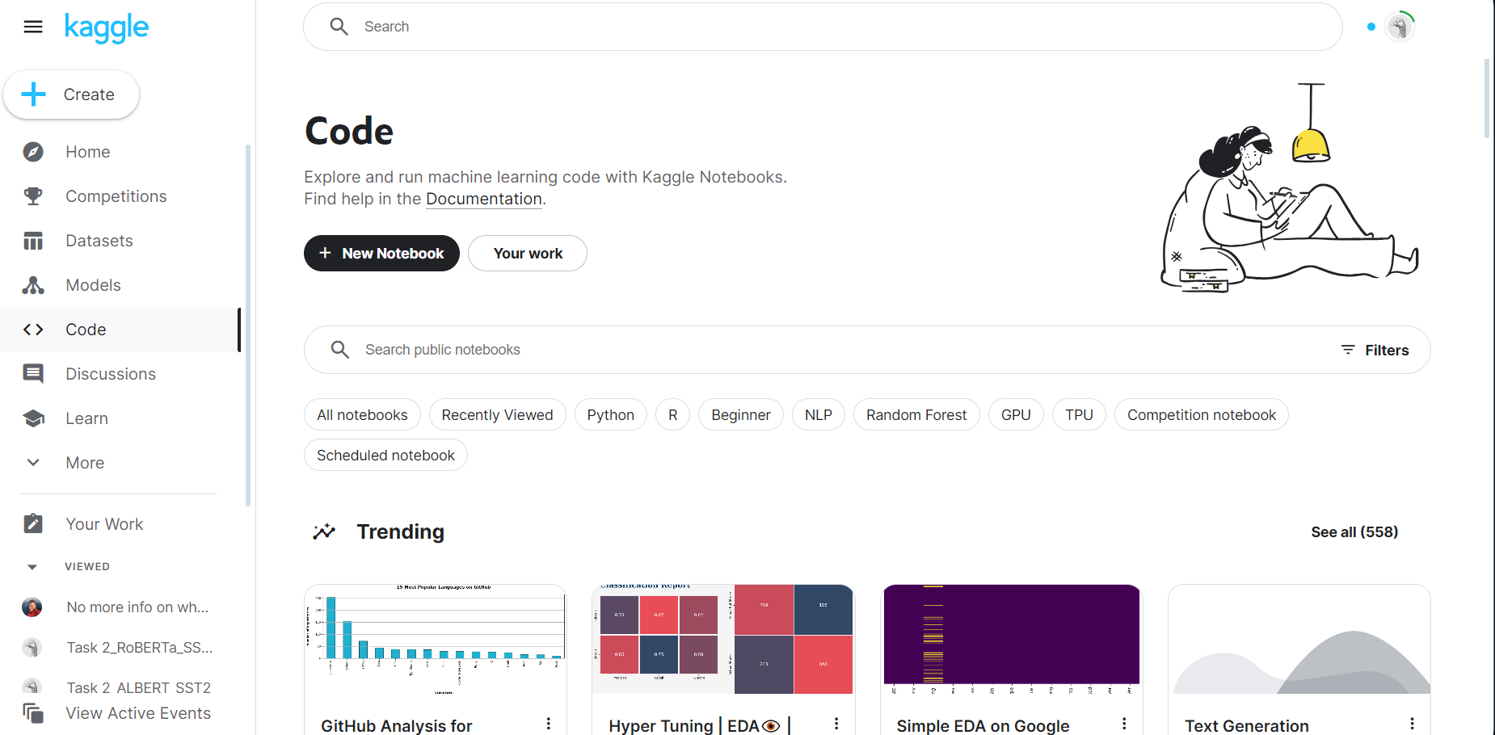
Step 1: Logging into your Kaggle account. The main page should look something like this

Slide 2
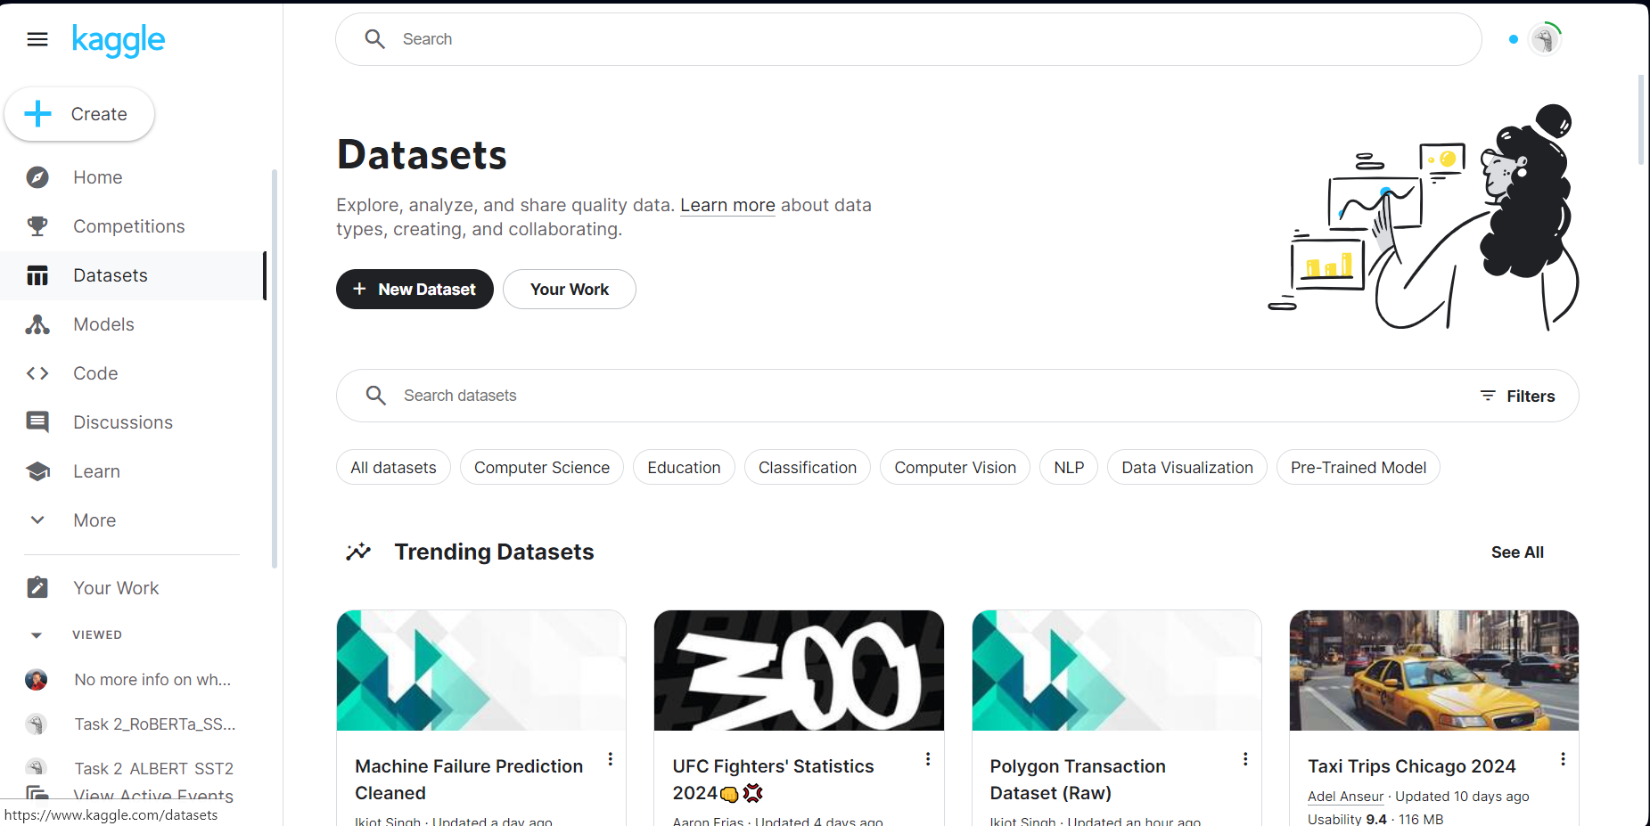
Step 2: Click on Dataset => Choosing “Your Work”

Slide 3
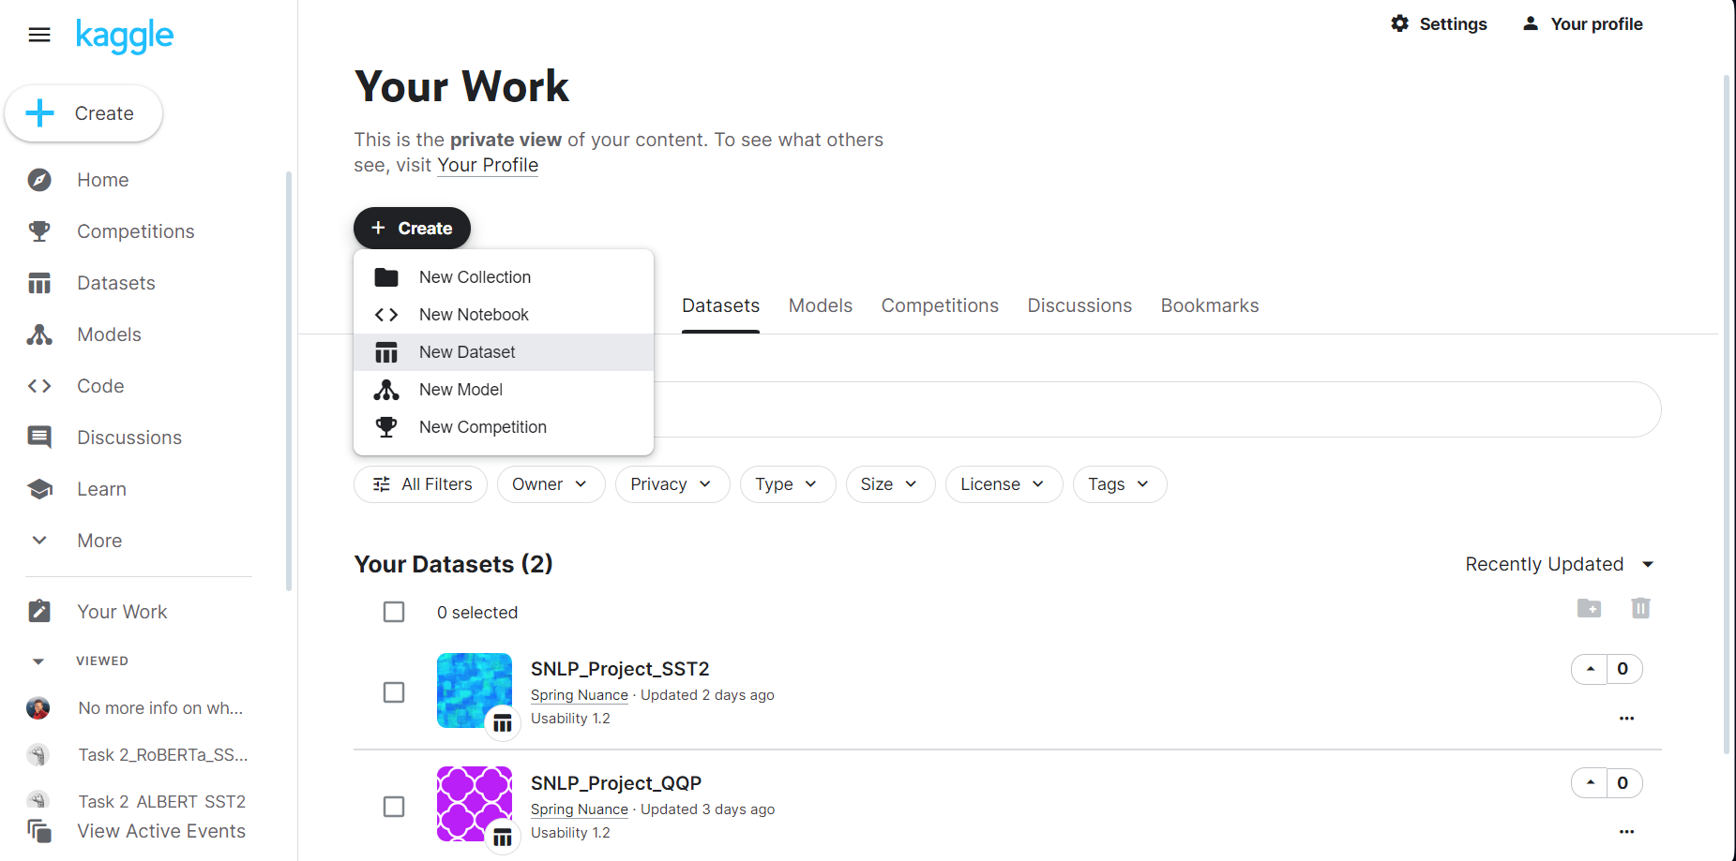
Step 3: Create New Dataset and upload QQP and SST2 dataset

Slide 4
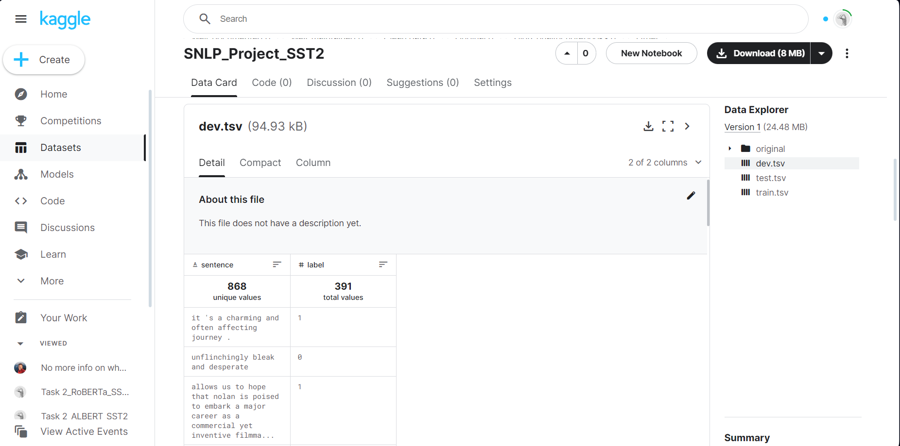
SST2 dataset contains dev.tsv, test.tsv and train.tsv

Slide 5
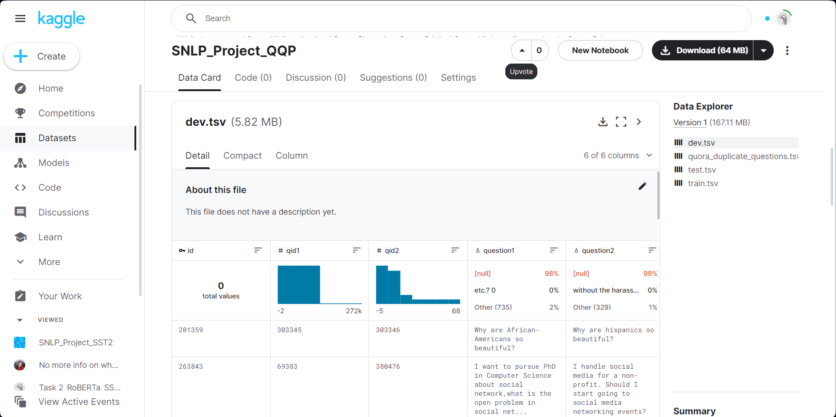
QQP dataset contains dev.tsv, test.tsv and train.tsv

Slide 6

Step 4: Click on Code tab => “Your work”

Slide 7
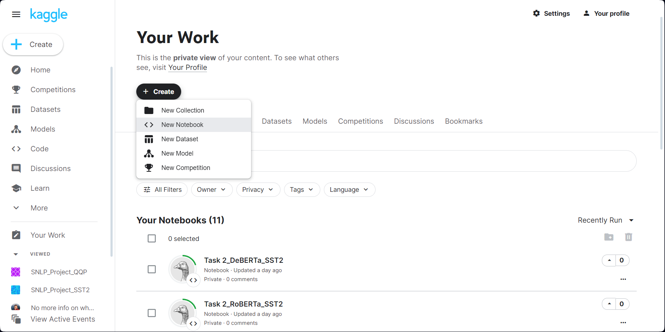
Step 5: Click on Create => “New notebook”

Slide 8
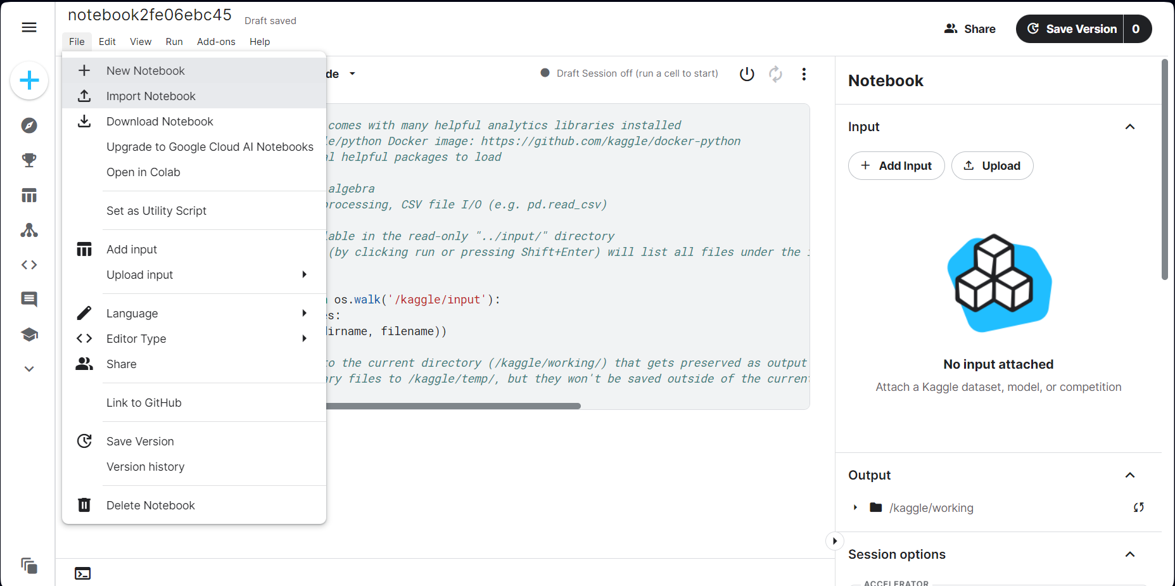
Step 6: Click on Import Notebook => Choose our ipynb developed notebook

Slide 9
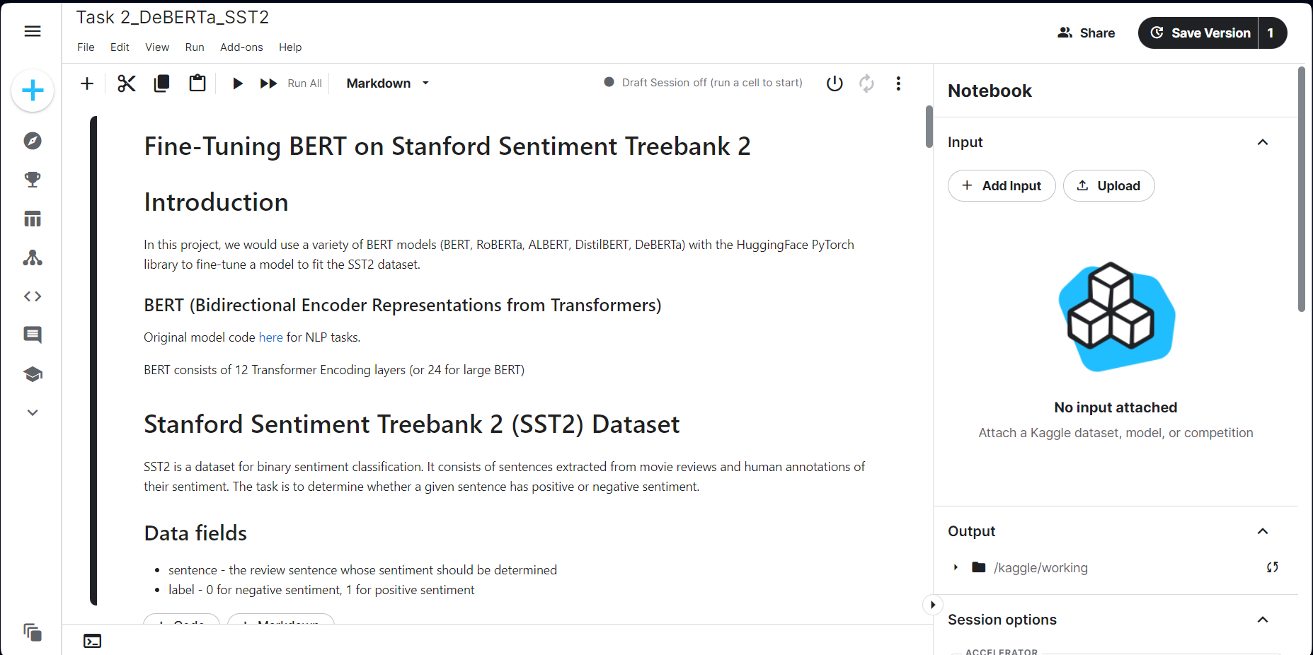
Step 6: Now your notebook should look like this. Then click on “Add input”

Slide 10
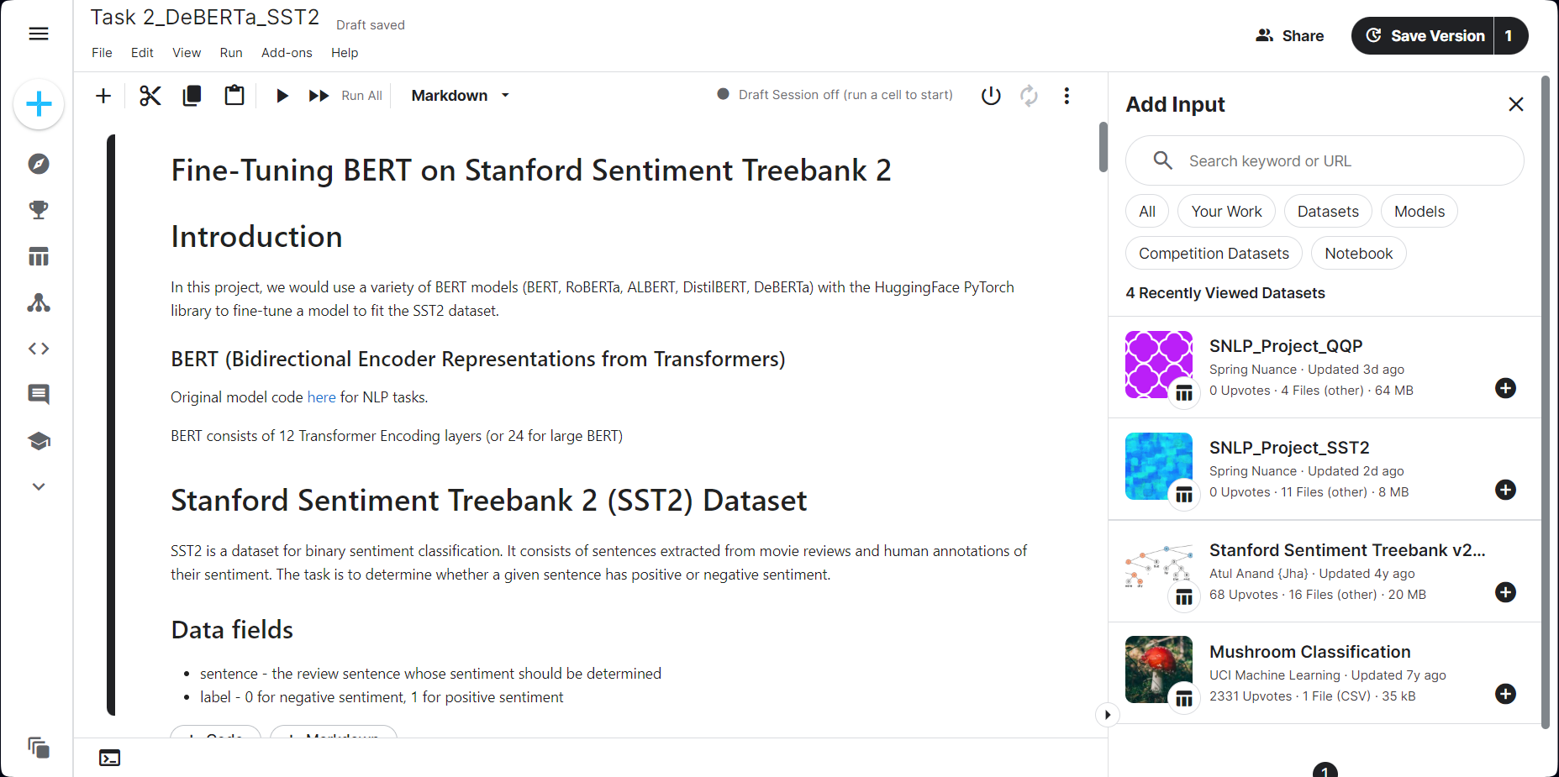
Step 7: Click on “Your work” and choose either QQP or SST2 dataset, depending on the task

Slide 11
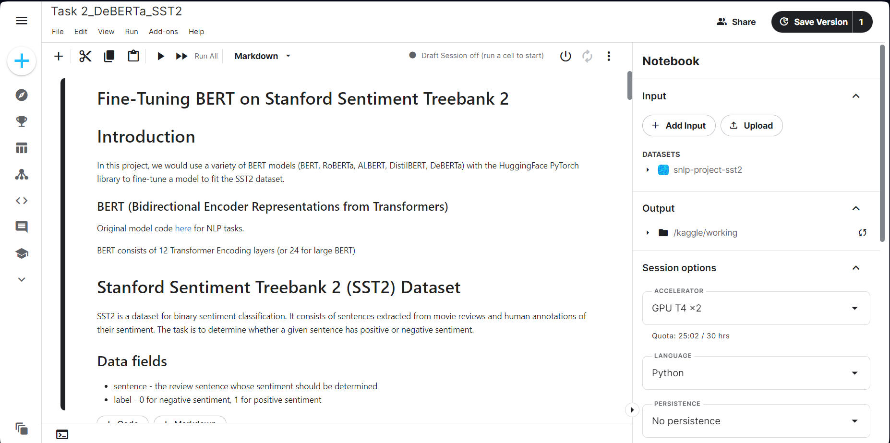
Step 7: Now the dataset has been loaded into your Input tab

